Slide 1
LGT 2106/LGT2B02 Principles of Operations Management Semester 2
Lecture 5
Operations Scheduling

Slide 2
Learning Outcomes
Explain operations scheduling.
Identify the elements of job shops scheduling.
Analyze scheduling problems using priority rules and more specialized techniques.
Identify the major elements of scheduling workers in service operations.
References: Jacobs & Chase, 15th ed, Chapter 22.

Slide 3
Introduction
Scheduling
defined as the prioritizing and sequencing of work.
a timetable for performing activities, using resources, or allocating facilities.

Slide 4
Scheduling in a Job Shop
Scheduling and control system must be capable of:
Allocating orders, equipment, and personnel to work center or other specified locations.
Determining the sequence of order performance.
Dispatching orders to the factory floor.
Maintaining shop floor/production activity control to review order status and expedite late or critical orders.
Revising the schedule to reflect changes in order status.
Assuring that quality control standards are met.

Slide 5
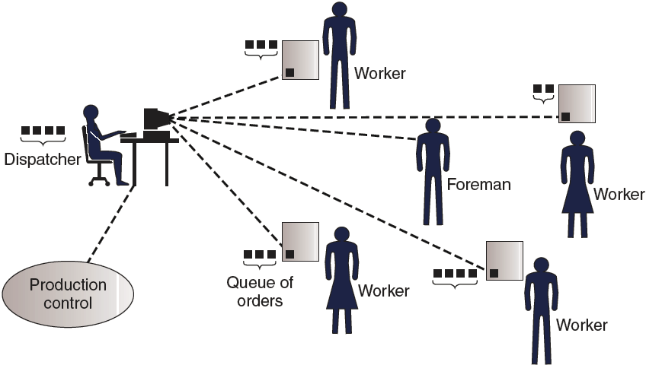
Typical Scheduling Process
Exhibit 12.1

Slide 6
Elements of Job Shop Scheduling
Job Arrival Patterns
Constant or random arrivals
Singly or in batches (bulk or lot arrivals)
High or normal priorities
The “Machinery” in the Shop
The Ratio of Skilled Workers to Machines
Machine-limited systems: capacity is determined by the number of machines.
Labor-limited systems: capacity is determined by the number of workers.
The Flow Pattern of Jobs through the Shop

Slide 7
Concepts
A job
Processing time
Due date
Flow time: the time a job spends in the process
= finish date of a job – arrival date of a job
Slack time remaining:
= time remaining before due date – remaining processing time
Lateness (tardiness)
A schedule of jobs
Makespan: the overall length of the schedule

Slide 8
Allocating Jobs to Machines
Priority Rules
FCFS—first-come, first-served
SPT—shortest processing (completion) time
Due date—earliest due date first
DDate—entire job
OPNDD—next operation
Start date—due date minus normal lead time
STR—slack time remaining
STR/OP—slack time remaining per operation
CR—(due date-current date)/work remaining
QR—slack time remaining/planned queue time
LCFS—last-come, first-served
Random order—whim operator’s choice of job to run

Slide 9
Schedule Evaluation Criteria
Standard measures of schedule performance used to evaluate priority rules:
Meeting due dates of customers or downstream operations.
Minimizing flow time (throughput or cycle time) that the job spends in the shop.
Minimizing work in process.
Minimizing idle time of machines and workers.

Slide 10

Scheduling n Jobs on One Machine
Scheduling 5 legal document photocopy jobs on one color photocopy machine received today.

Slide 11
Scheduling n Jobs on One Machine
Total flow time = 3+7+9+15+16 = 50 days Mean flow time = 50/5 = 10 days
Average days late/job = 4.6 days

Slide 12
Scheduling n Jobs on One Machine
Total flow time = 1+3+6+10+16 = 36 days Mean flow time = 36/5 = 7.2 days
Average days late/job = 2.4 days

Slide 13
Scheduling n Jobs on One Machine
Total flow time = 1+4+8+10+16 = 39 days Mean flow time = 39/5 = 7.8 days
Average days late/job = 2.4 days

Slide 14
Scheduling n Jobs on One Machine
Total flow time = 1+7+9+13+16 = 46 days Mean flow time = 46/5 = 9.2 days Average days late/job = 4.0 days

Slide 15
Scheduling n Jobs on One Machine
Total Flow time = 6+8+11+12+16 = 53 days Mean flow time = 53/5 = 10.6 days Average days late/job = 5.4 days

Slide 16
Scheduling n Jobs on One Machine
Total Flow time = 1+4+8+14+16 = 43 days Mean flow time = 43/5 = 8.6 days Average days late/job = 3.2 days

Slide 17
Scheduling n Jobs on One Machine
Scheduling Rule | Total Flow Time (days) | Mean Flow Time (days) | Average Lateness (days)
FCFS SPT DDate LCFS Random STR | 50 36 39 46 53 43 | 10.0 7.2 7.8 9.2 10.6 8.6 | 4.6 2.4 2.4 4.0 5.4 3.2

Slide 18
Scheduling n Jobs on Two Machines
Two or more jobs must be processed on two machines in a common sequence
Wish to minimize the makespan of the schedule - from the beginning of the first job to the finish of the last job
Example:
Job | Machine 1 (printing) | Machine 2 (binding)
A | 3 | 6
B | 4 | 5
/ | 1
/ | 2

Slide 19
Scheduling n Jobs on Two Machines
Johnson’s Rule (Method)
List the operation time for each job on both machines.
Select the shortest operation time.
If the shortest operation time is on the first machine, do that job first; if the shortest time is on the second machine, do the job last. (Break ties arbitrarily.)
Repeat steps 2 and 3 for each remaining job until the schedule is complete.

Slide 20
Optimal Schedule of Jobs Using Johnson’s Rule - Example
Job | Operation Time on Machine 1 | Operation Time on Machine 2
A | 3 | 2
B | 6 | 8
C | 5 | 6
D | 7 | 4
Decision steps:
Select Job A, and assign it as the last job to be processed.
Select Job D, assign it as the 2nd last job.
Select Job C, assign it as the 1st job.
Select Job B, assign it as the 2nd job.

Slide 21
Optimal Schedule of Jobs Using Johnson’s Rule - Example
Job | Operation Time on Machine 1 | Operation Time on Machine 2
A | 3 | 2
B | 6 | 8
C | 5 | 6
D | 7 | 4

Slide 22
Optimal Schedule of Jobs Using Johnson’s Rule - Example
Job | Operation Time on Machine 1 | Operation Time on Machine 2
C | 5 | 6
B | 6 | 8
D | 7 | 4
A | 3 | 2
Machine 1 | Job C (5) |  |  |  |  | Job B (6) | Job D (7) | Job A (3)
Machine 2 |  |  |  |  |  | Job C (6) | Job B (8) |  | Job D (4) |  |  | Job A (2)
Days
5
11
19
23
25

Slide 23
The End
Thank You

